Slide 1



How To Catch
People who Cheat
The Stock Market!
MIT Fintech Challenge
February 22nd 2020

Slide 2
How To Catch
People who Cheat
The Stock Market!
MIT Fintech Challenge
February 22nd 2020

Slide 3

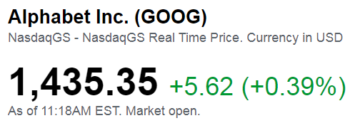

Background
What is a Stock Price?

Slide 4
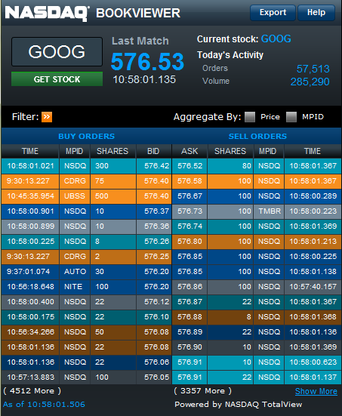
Background
ASK | SHARES
576.88 | 10
576.87 | 10
576.86 | 8
576.85 | 22
576.83 | 250
576.80 | 100
576.74 | 200
576.73 | 120
576.67 | 100
576.58 | 100
576.52 | 80
What is a Stock Price REALLY….
SHARES | BID
300 | 576.42
75 | 576.41
500 | 576.40
10 | 576.37
10 | 576.36
8 | 576.30
2 | 576.26
30 | 576.25
100 | 576.20
22 | 576.18
22 | 576.12

Slide 5
I OWN GOOGLE STOCK AND WANT TO SELL AS HIGH AS POSSIBLE
Spoofing Example
I have an offer of 100 lots at 576.58
I then add a bid of 20,000 lots at 576.42, to look like a large increase in demand
Scared, someone else lifts the offer and buys my stock at 576.58
BOOM!
Market trades up at 576.58, and I sell 80 lots of Google Stock.
I remove my bid…!
ASK | #
576.86 | 8
576.85 | 22
576.83 | 250
576.80 | 100
576.74 | 200
576.73 | 120
576.67 | 100
576.58 | 100
ASK | #
576.86 | 8
576.85 | 22
576.83 | 250
576.80 | 100
576.74 | 200
576.73 | 120
576.67 | 100
576.58 | 100
ASK | #
576.86 | 8
576.85 | 22
576.83 | 250
576.80 | 100
576.74 | 200
576.73 | 120
576.67 | 100
576.58 | 20
# | BID
300 | 576.42
75 | 576.41
500 | 576.40
10 | 576.37
10 | 576.36
8 | 576.30
2 | 576.26
30 | 576.25
# | BID
20,300 | 576.42
75 | 576.41
500 | 576.40
10 | 576.37
10 | 576.36
8 | 576.30
2 | 576.26
30 | 576.25
# | BID
220 | 576.42
75 | 576.41
500 | 576.40
10 | 576.37
10 | 576.36
8 | 576.30
2 | 576.26
30 | 576.25

Slide 6
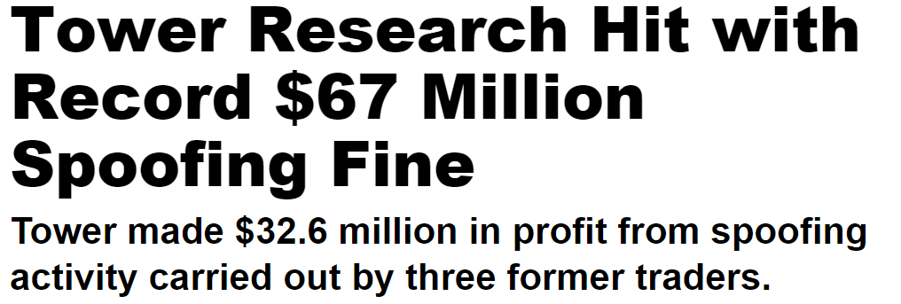

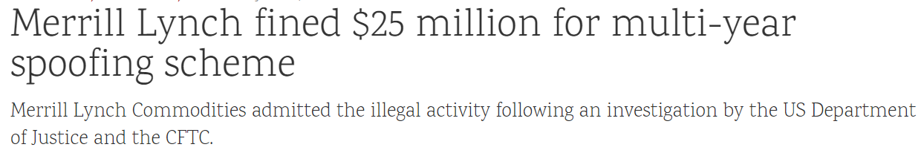
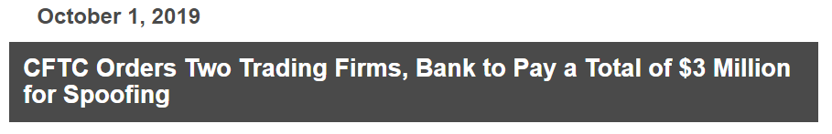
This is called “Spoofing”
i.e. Entering orders with no intent to trade
It is highly illegal, and leads to huge fines for financial institutions!

Slide 7
Hackathon Challenge
CONTEXT:
Spoofing is the activity of entering trading orders with no intention to actually trade; to manipulate the market price. This is often done to benefit a traders current positions and increase their PnL.
This is a BIG PROBLEM. It carries financial and reputational risk, and is strictly prohibited by all major financial regulators.
Nevertheless, companies like Citi execute millions of trade orders every day, and it is impossible to track, observe and analyze every single trading order that is made.
GOAL:
To systematically identify trading activity which has no desire to actually trade (i.e. spoofing), that can be applied to huge data sets of trading activity.

Slide 8
Hackathon Challenge
CHALLENGE:
Identify Spoofing in large sets of trading data.
We will be providing sample data and pandas dataframe with a simple model. Use this for your analysis – we will assess your accuracy on test data in the same format.
DELIVERABLES:
A model identifying “Top of Book” spoofing (as shown in the Spoofing example)
A model identifying 2 other types of spoofing hidden in the data
A graphical interface, UI, or set of charts that show your results (real-time or historical)
4) A slide deck outlining you approach, as well as thoughts on:
Non-quantitative ways of identifying illegitimate trading (or traders!)
Ideas of policies or procedures that could be implemented to reduce spoofing (e.g. leveraging psychology or behavioral economics)
The potential benefits and upside to financial firms for implementation

Slide 9
Resources
DATA:
https://github.com/angelajinyq/MIT-Fintech-Challenge
READING:
How To Catch A Spoofer - https://www.bloomberg.com/graphics/2015-spoofing/
Financial Surveillance Using Big Data - http://www.it.uu.se/edu/course/homepage/projektDV/ht17/project-2017-technical.pdf%200
THINGS TO THINK ABOUT:
Understand what spoofing is and think about how YOU would might cheat the market, before diving in to solutions
Explore and familiarize yourself with the data before diving in too deep
Think about Repeat Behavior by the same users
Some techniques that might be relevant: Naïve Bayes, Logistic Regression, RNN, HMM
Finally, remember… intent is difficult to prove, and genuine mistakes might happen.

Slide 10
Q&A
Thank you

